Slide 1
Factors Associated with Global Climate Change other than Greenhouse
Christopher R. Neilson

Slide 2

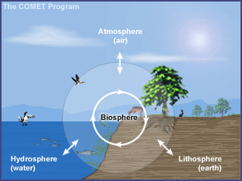
Retreating Glaciers/Sea level rising
Dying Forests/Overpopulation of Foreign Species
Mass Extinctions/Disruptions in Natural Food Chains
Notes:
Ex – Spruce Bark Beetle

Slide 4
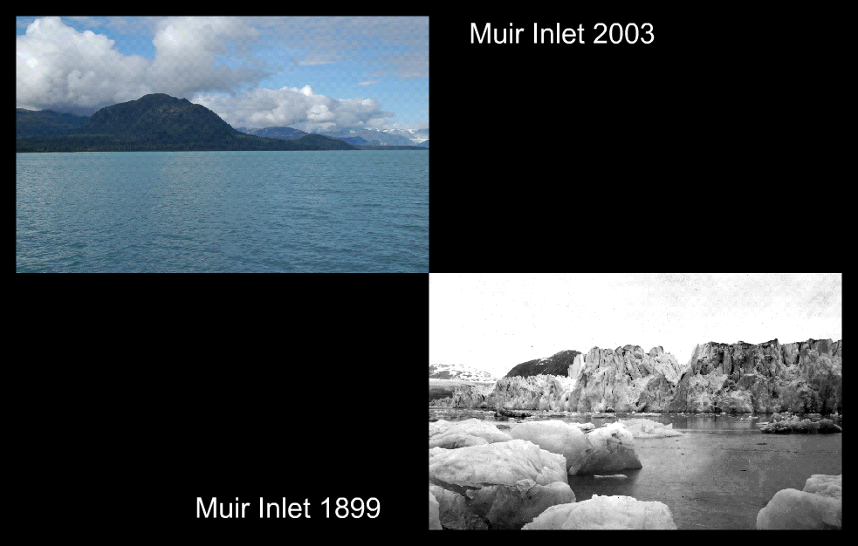

Slide 6
Milankovitch Cycles
Urban Heat Island
Land Surface Changes
Volcanic Eruptions
Variations in Solar Activities

Slide 7
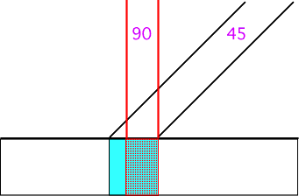

Slide 8
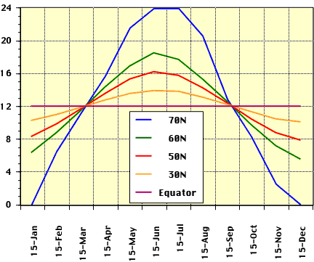

Slide 9
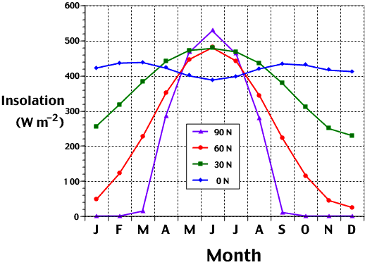

Slide 10
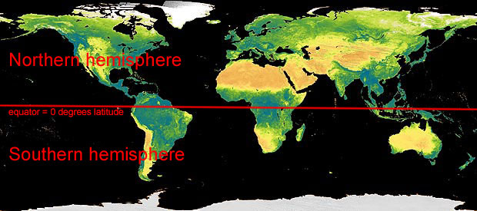

Slide 11
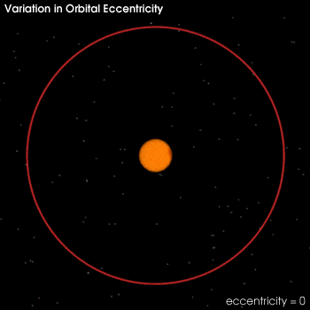
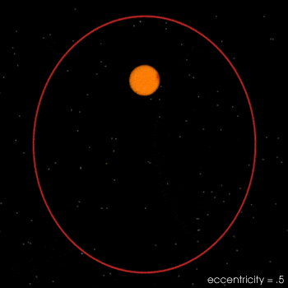

Slide 12
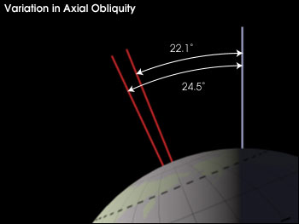

Slide 13
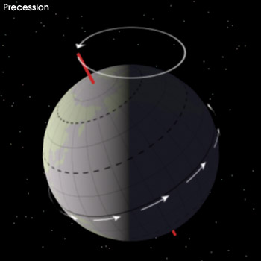

Slide 14
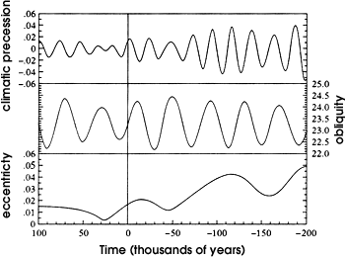

Slide 15
